Slide 1
31482 HONOURS PROJECT · PITCH ON THE RESEARCH UNDERTAKEN
Deep Reinforcement Learning for Multi-Agent Coordination in Mixed Human-Robot Warehouses
What does a learned coordination policy add to a robot fleet that shares its aisles with people, and what does it cost?
Mohammed Al-Khudhair
Bachelor of Computing Science (Honours) · Supervisor: Dr Mingshan Jia · Spring 2026
Video link: https://drive.google.com/file/d/1WCTpqxSP0kFV5mxgYz68P66T8bWF07AL/view?usp=sharing

Slide 2
RESEARCH BACKGROUND · THE PROBLEM
Robots and people now share the same aisles
Classical controllers assume a robot-only floor
Path planners and reactive avoidance work well when every agent is a robot.
8-15%
of operating time is lost to robot idle time spent avoiding human workers
People are harder to predict
Robots stop abruptly, keep oversized buffers, or come too close.
Boysen, de Koster & Weidinger (2019)
Safety standards set the bar
ISO 10218 and ISO 15066 define how close a robot may come to a person.
Mohammed Al-Khudhair · 31482 Honours Project
2 / 15

Slide 3
RESEARCH BACKGROUND · LITERATURE
What the literature offers, and what it leaves open
Classical coordination
Learning-based coordination
MAPF (Sharon et al., 2015; Silver, 2005): plans collision-free paths in advance, built for static, robot-only settings.
MADDPG, MAPPO (Lowe et al., 2017; Yu et al., 2022): centralised training, decentralised execution for teams.
ORCA / RVO (van den Berg et al., 2011): picks safe velocities in real time, with no memory and no learning.
PRIMAL2 (Damani et al., 2021) and Gao et al. (2024): learning at warehouse scale, but robot-only.
Learned coordination with people who move and react, tested against the controllers warehouses actually use, is largely unexplored.
THE GAP
Mohammed Al-Khudhair · 31482 Honours Project
3 / 15

Slide 4
RESEARCH BACKGROUND · AIM
Aim and research objectives
Design, train and evaluate a multi-agent deep reinforcement learning framework that coordinates warehouse robots around people, and measure what it gains and costs against classical controllers.
O1
O2
O3
O4
Build and validate a mixed human-robot simulator
Train a CTDE PPO policy with a safety-aware reward
Compare it with classical controllers on industry KPIs
Test how well it holds up beyond its training conditions
Slide 6
Slide 7
Slides 8 and 9
Slide 10
Mohammed Al-Khudhair · 31482 Honours Project
4 / 15

Slide 5
RESEARCH BACKGROUND · FROM LITERATURE TO DESIGN
How the literature shaped this project
What the literature showed | What this project does with it
CTDE works for cooperative teams (Lowe et al., 2017; Yu et al., 2022) | One shared actor per robot; a critic sees the full state only during training
Imitation speeds up learning (Damani et al., 2021; Rajeswaran et al., 2018) | Warm start by copying ORCA, with the pull towards it fading over 2M steps
ISO 10218 and ISO 15066 set separation limits | A 0.8 m safety zone, penalised in training and measured as a KPI
Avoidance costs warehouses time (Boysen et al., 2019) | Throughput and congestion measured alongside safety
RL results are fragile without care (Agarwal et al., 2021) | 10 seeds, seed-level statistics, hypotheses registered in advance
Mohammed Al-Khudhair · 31482 Honours Project
5 / 15

Slide 6
DESIGN · OBJECTIVE 1
Simulation and experimental design
6
24
layouts: 2 small, 2 medium, 2 large
conditions: layouts × demand × density
4
10
controllers: ORCA, heuristic, MAPF, PPO
training seeds, 10M steps each
140
2,880
training runs, 20.5 hours on one PC
test episodes in the main comparison
illustrative heights; the simulation is 2D.
Mohammed Al-Khudhair · 31482 Honours Project
6 / 15

Slide 7

IMPLEMENTATION · OBJECTIVE 2
CTDE PPO with a safety-aware reward
Architecture
Reward (v2)
Local view
Shared actor
Action
Event | Reward
Delivery completed | +10
Progress towards target | +0.5 per m
Inside the 0.8 m ISO zone | up to -1.2
Collision starts | -3.0
Contact continues | -0.25 per step
Wall contact | -1.0
26 values per robot
one network, all robots
stay or 1 of 8 moves
Training only: centralised critic
Scores each robot from the full warehouse state, so no central controller is needed once deployed
Warm start: copy ORCA's actions, then fade that pull out over the first 2M steps
BUILT ITERATIVELY
A pilot and two development batches caught two bugs: a collision threshold robots could never reach, and 83-second episodes too short to measure throughput.
Mohammed Al-Khudhair · 31482 Honours Project
7 / 15

Slide 8
RESULTS · OBJECTIVE 3
Much safer, slightly slower
-46%
-25%
-7.5%
Lowest
fewer collisions
fewer ISO-zone entries
throughput (the cost)
congestion of all four
Controller | Orders/h | Collisions | ISO entries | Congestion | m/delivery
ORCA / RVO | 302 | 8.31 | 0.69 | 0.03 | 55.1
Heuristic | 257 | 5.07 | 0.44 | 0.15 | 56.2
MAPF | 300 | 7.73 | 0.70 | 0.03 | 55.5
CTDE PPO (this work) | 279 | 4.48 | 0.52 | 0.02 | 62.8
Tiles compare with ORCA. Interquartile means over 24 conditions and 10 seeds; collisions per 100 steps, ISO entries per robot-human interaction. Chance a PPO seed is safer than ORCA in a condition: 0.93 (collisions), 0.94 (ISO).
Mohammed Al-Khudhair · 31482 Honours Project
8 / 15

Slide 9
RESULTS · OBJECTIVE 3
The reward decides where PPO lands
Policy (Small 1) | Orders / h | Collisions | ISO entries | What it shows
ORCA / RVO | 350 | 8.29 | 0.78 | The reference
PPO, v1 reward | 231 | 3.93 | 0.46 | Per-step penalties: safe but slow
PPO, full v2 reward | 312 | 4.68 | 0.60 | The balance used throughout
PPO, throughput only | 364 | 7.98 | 0.80 | Beats ORCA's throughput
PPO, safety only | 0 | 6.23 | 0.12 | Learns never to deliver
Learning can add throughput
The full reward spends it on safety
Rewarded only for throughput, PPO beats ORCA (364 vs 350 orders per hour).
The weights choose the operating point on the safety and throughput trade-off.
Mohammed Al-Khudhair · 31482 Honours Project
9 / 15

Slide 10
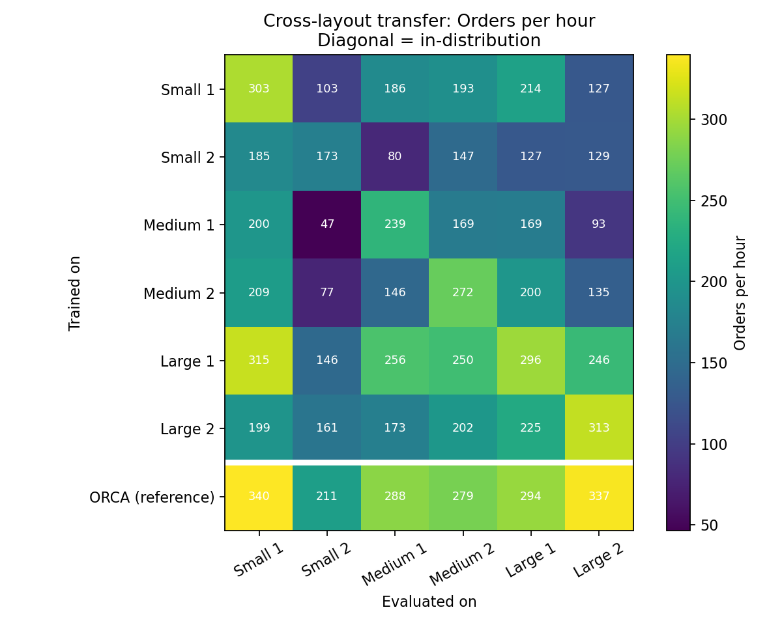
RESULTS · OBJECTIVE 4
The safety advantage holds beyond training
Denser crowds than in training
5 to 7 people: 42% fewer collisions than ORCA (6.10 vs 10.49), 7% lower throughput
More robots than in training
5 to 6 robots: 48% fewer collisions than ORCA (12.1 vs 23.1), 4% lower throughput
People behaving differently
20% faster, 20% slower, or keeping wider space: the safety-zone advantage over ORCA held in all 10 tests
Unseen layouts: large-layout policies transfer best; on Large 1, PPO matches ORCA (296 vs 294)
Mohammed Al-Khudhair · 31482 Honours Project
10 / 15

Slide 11
CONCLUSIONS · PRE-REGISTERED HYPOTHESES
9 of 10 hypotheses supported
# | Hypothesis (PPO unless stated) | Result
H1 | Fewer collisions than ORCA and MAPF | Supported: 4.48 vs 8.31, 7.73
H2 | Fewer ISO-zone entries than ORCA and MAPF | Supported: 0.52 vs 0.69, 0.70
H3 | Lower throughput than ORCA and MAPF | Supported: 279 vs 302, 300
H4 | Smaller throughput gap to ORCA than at 6M steps (5.1%) | Not supported: gap 7.5%
H5 | Faster and less congested than the heuristic | Supported: 279 vs 257; 0.02 vs 0.15
H6 | The heuristic has fewer ISO-zone entries than PPO | Supported: 0.44 vs 0.52
H7 | The v2 reward gives higher throughput than v1 | Supported: 312 vs 231
H8 | Safety-only reward gives lower throughput than full | Supported: 0 vs 312
H9 | Throughput-only reward gives more collisions than full | Supported: 7.98 vs 4.68
H10 | ISO-zone advantage over ORCA holds under every behaviour change | Supported: all 10 tests
Registered on 25 September 2026, before the final run. H4 compares with a development run evaluated on different test episodes.
Mohammed Al-Khudhair · 31482 Honours Project
11 / 15

Slide 12
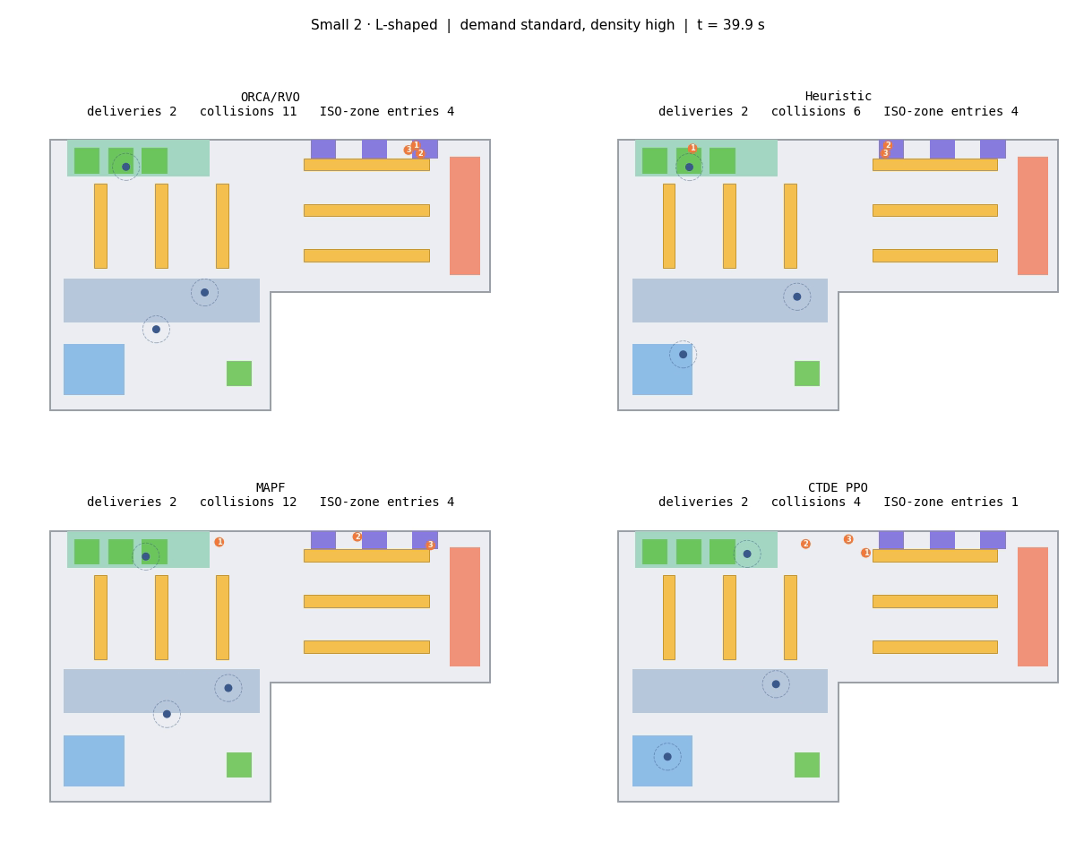
CONCLUSIONS
What the results show
1
Learning adds safety that fixed rules miss
46% fewer collisions and 25% fewer ISO-zone entries than ORCA; the fewest collisions of any controller.
2
The cost is modest, and still falling
7.5% less throughput overall, parity with ORCA on Large 1, and throughput still rising at 10M steps.
3
The reward sets the operating point
Throughput-only PPO beats ORCA; the full reward spends that margin on safety instead.
One illustrative 40-second episode (Small 2): PPO 4 collisions and 1 ISO-zone entry, ORCA 11 and 4
Mohammed Al-Khudhair · 31482 Honours Project
12 / 15

Slide 13
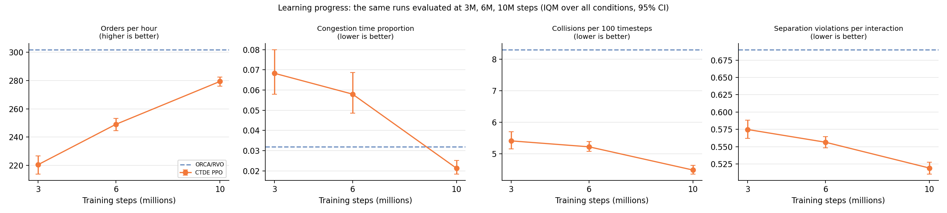
CONCLUSIONS · ISSUES
Issues and limitations
Not converged
Safety set by weights
Simulation only
Uneven gains
Throughput still rising: 220, 249, 279 orders per hour at 3M, 6M, 10M steps
Not a budget an operator can state and rely on
2D, simulated people, and no test on real robots
Medium 1 lags ORCA (239 vs 288); curriculum and demand arms gave no clear gain
Mohammed Al-Khudhair · 31482 Honours Project
13 / 15

Slide 14
CONCLUSIONS · FUTURE WORK
Extending this to a research degree
NEXT MONTHS
MPHIL OR PHD
TOWARDS DEPLOYMENT
Finish the story
Safety you can specify
From simulation to floor
Train to convergence
GPU-native simulation for far more experience
Find out why Medium 1 is hard to learn
Constrained multi-agent RL with a stated safety budget
Predict human motion from real pedestrian data
3D simulation with realistic human bodies
Sim-to-real on a small robot testbed
Test against ISO 10218 and ISO 15066
Study how workers experience learned robots
Can a warehouse fleet learn to meet a safety budget an operator states, while matching classical throughput?
HDR QUESTION
Mohammed Al-Khudhair · 31482 Honours Project
14 / 15

Slide 15
IN ONE SENTENCE
Learning made shared aisles markedly safer, at a small and shrinking cost in throughput.
46%
9 of 10
Open
fewer collisions than ORCA
pre-registered hypotheses supported
code, results and pre-registration in one repository
Thank you. Questions welcomed.
Mohammed.Al-Khudhair@student.uts.edu.au

